Slide 1
Which is the better Minesweeper design?
(a)
(b)
Logic
Minefield
Storage
Logic
Minefield
Storage
:Logic
m:Minefield
:Storage
:Logic
m:Minefield
:Storage
mark
mark
mark
mark
update(m)
update(m)
get info
get info

Slide 2
Design Fundamentals
Abstraction
Coupling
Cohesion

Slide 3
Abstraction

Slide 4
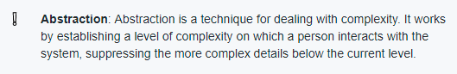

Abstraction
Which of these are using the design concept of Abstraction?
Wait, is that the right abstraction?
The ArrayList class in Java
The ArrayList#add() method
A class diagram

Slide 5

Design Fundamentals
Abstraction
Coupling
Cohesion
Use it!

Slide 6
Dependency =>
Coupling
Component A
Component B
(Class/method/…)
If I change B , will it require a change in A ?
NO WAY
It might

Slide 7
Coupling
Component A
Component B
If I change B , will it require a change in A ?

Slide 8
Coupling
Component A
Component B
If I change B , will it require a change in A ?

Slide 9

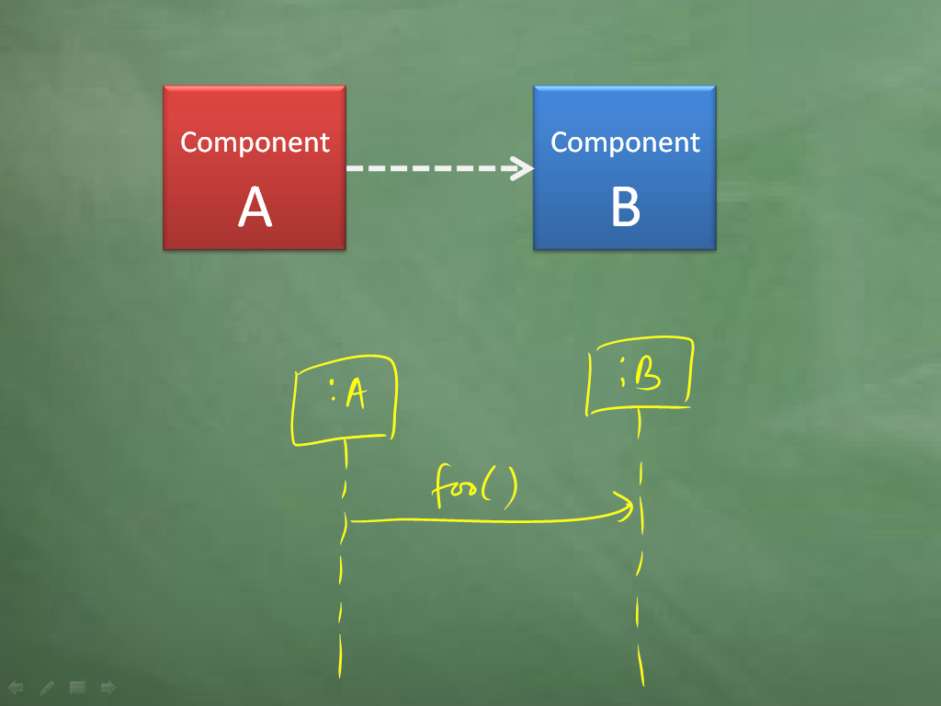
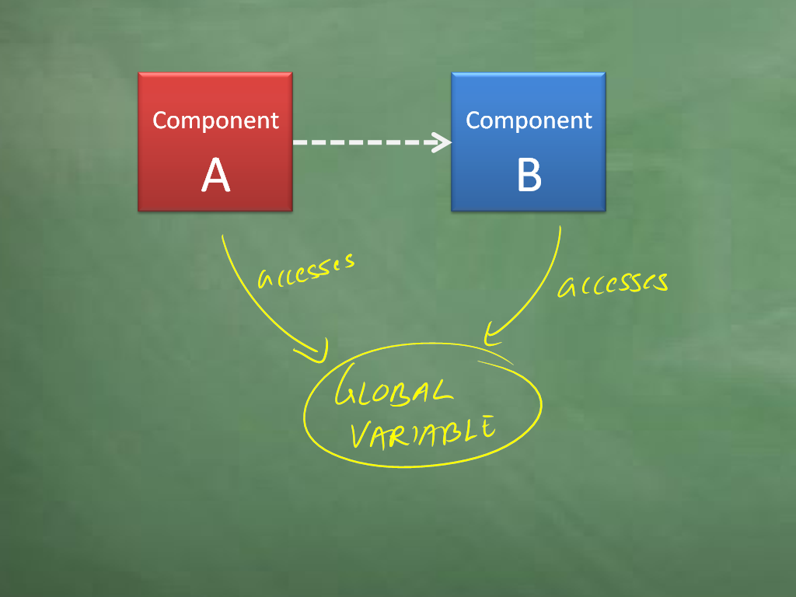
Coupling
Component A
Component B

Slide 10
Component A
Component B
If I change B, will it require a change in A? Yes, It might
Reduce coupling

Slide 11

Design Fundamentals
Abstraction
Coupling
Cohesion
Use it!
Reduce!

Slide 12
Does one thing and does it all
cohesion
Component A
Component B
Component C

Slide 13
Does one thing and does it all
cohesion
Window 1
Component A
Window 2
Window 3

Slide 14
Does one thing and does it all
cohesion
Component A
Component B
Component C

Slide 15
Does one thing and does it all
cohesion
Component A
Component B
Component C

Slide 16
Does one thing and does it all
cohesion
Component A
Component B
Component C

Slide 17
Does one thing and does it all
cohesion
Component A
Component B
Component C
Increase cohesion

Slide 18
Design Fundamentals
UI
Parser
Logic
Abstraction
Coupling
Cohesion
Use it!
Reduce!
Improve!

Slide 19
Which is the better Minesweeper design? Why?
(a)
(b)
Logic
Minefield
Storage
Logic
Minefield
Storage
:Logic
m:Minefield
:Storage
:Logic
m:Minefield
:Storage
mark
mark
mark
mark
update(m)
update(m)
get info
get info

Slide 21

Gems of Wisdom:
Software Engineering Principles.

Slide 22

Principle of Separation of Concerns (SoC)
To achieve better modularity, separate the code into distinct sections, such that each section addresses a separate concern.
by Edsger Dijkstra
SYSTEM
Refresh data storage
Interact with user
Show message to user
Authenticate user
Get user input
Store user data
Encrypt password

Slide 23

Single Responsibility Principle (SRP)
A class should have one, and only one, reason to change.
by Robert C. Martin (aka Uncle Bob)
TextUi
Formatter
TextUi
“Gather together the things that change for the same reasons. Separate those things that change for different reasons.”
Opposite: God class

Slide 24
How does this application of SRP change C & C?
TextUi
Formatter
TextUi
Errors
Errors
Improves both
Improves cohesion only
Improves coupling only
Doesn’t improve either one

